Slide 1
Cooling Loop Simulink Model

Slide 2
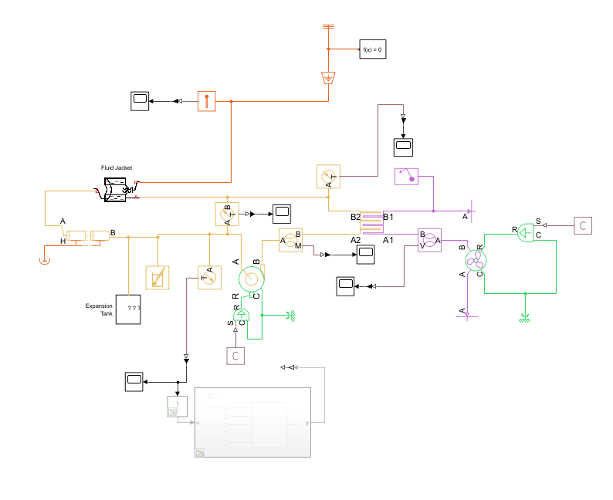
Current System Model 4/25/2026

Slide 3
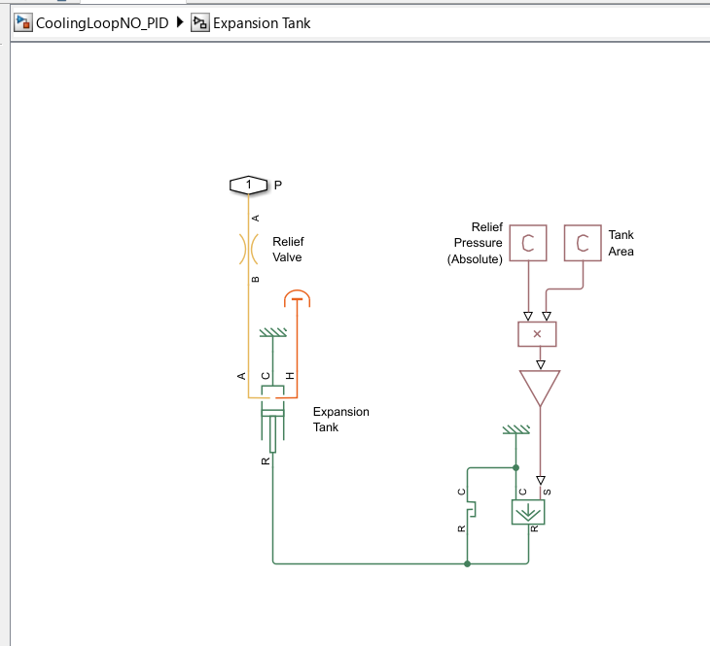
Expansion Tank

Slide 4
Behavior
Increase in fan speed decreases SS temp
Increase in thermal energy input increases SS temp
Increase in pump speed RPM increases liquid flow rate
Increase in pump speed RPM unpredictable effect on SS temp

